Slide 2
learn anatomy of a MapReduce Job Run

Slide 3
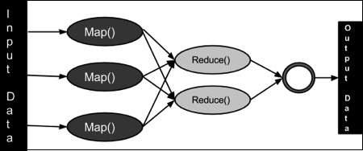
Introduction

Slide 4
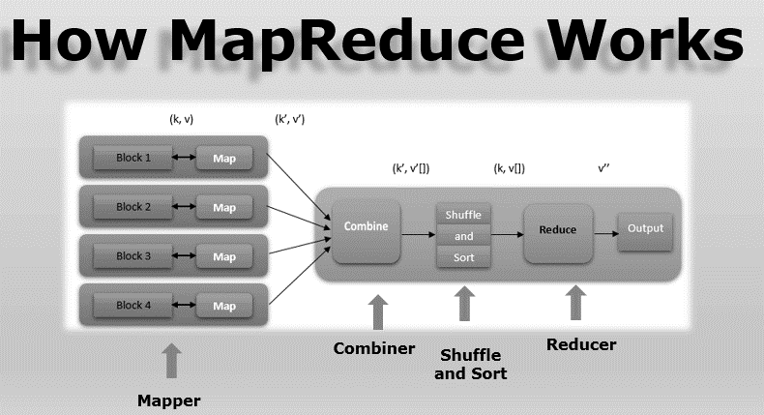
Introduction

Slide 5
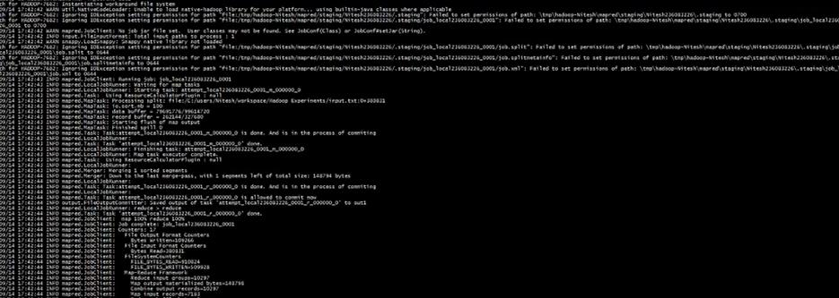
Introduction
Job Execution and job Completion

Slide 6
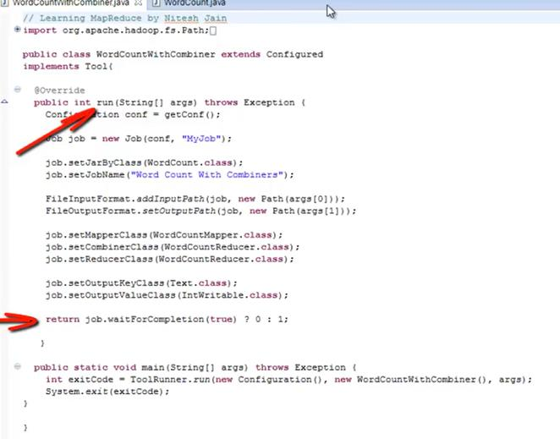
Introduction
Last statement in run method

Slide 7
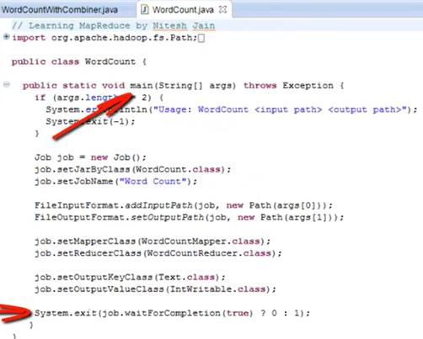
Introduction
Last line in main method

Slide 8
What happened behind the scene?
Jobs gets submitted by WaitforCompletion().
Properties that decide the job run:
  “mapred.job.tracker” (for 0.22 release)
    This is set in mapred-site.xml
    Default is local.
    Set as host:part
  “mapreduce.framework.name” (for .23 and later(eg 1.X.X)):
    Can be set to local,classic or yarn

Slide 9
What happened behind the scene?
Jobs gets submitted by WaitforCompletion().
Properties that decide the job run:
  “mapred.job.tracker” (for 0.22 release)
    This is set in mapred-site.xml
    Default is local.
    Set as host:part
  “mapreduce.framework.name” (for .23 and later(eg 1.X.X)):
    Can be set to local,classic or yarn

Slide 10
What happened behind the scene?
Jobs gets submitted by WaitforCompletion().
Properties that decide the job run:
  “mapred.job.tracker” (for 0.22 release)
    This is set in mapred-site.xml
    Default is local.
    Set as host:part
  “mapreduce.framework.name” (for .23 and later(eg 1.X.X)):
    Can be set to local,classic or yarn

Slide 11
What happened behind the scene?
Jobs gets submitted by WaitforCompletion().
Properties that decide the job run:
  “mapred.job.tracker” (for 0.22 release)
    This is set in mapred-site.xml
    Default is local.
    Set as host:part
  “mapreduce.framework.name” (for .23 and later(eg 1.X.X)):
    Can be set to local,classic or yarn

Slide 12
What happened behind the scene?
Jobs gets submitted by WaitforCompletion().
Properties that decide the job run:
  “mapred.job.tracker” (for 0.22 release)
    This is set in mapred-site.xml
    Default is local.
    Set as host:part
  “mapreduce.framework.name” (for .23 and later(eg 1.X.X)):
    Can be set to local,classic or yarn

Slide 13
What happened behind the scene?
Jobs gets submitted by WaitforCompletion().
Properties that decide the job run:
  “mapred.job.tracker” (for 0.22 release)
    This is set in mapred-site.xml
    Default is local.
    Set as host:part
  “mapreduce.framework.name” (for .23 and later(eg 1.X.X)):
    Can be set to local,classic or yarn

Slide 14
What happened behind the scene?
Jobs gets submitted by WaitforCompletion().
Properties that decide the job run:
  “mapred.job.tracker” (for 0.22 release)
    This is set in mapred-site.xml
    Default is local.
    Set as host:part
  “mapreduce.framework.name” (for .23 and later(eg 1.X.X)):
    Can be set to local,classic or yarn

Slide 15
What happened behind the scene?
Jobs gets submitted by WaitforCompletion().
Properties that decide the job run:
  “mapred.job.tracker” (for 0.22 release)
    This is set in mapred-site.xml
    Default is local.
    Set as host:part
  “mapreduce.framework.name” (for .23 and later(eg 1.X.X)):
    Can be set to local,classic or yarn

Slide 16

Classic MapReduce - Overview

Slide 17
Classic MapReduce - Overview
Job Tracker
Job Tracker node

Slide 18

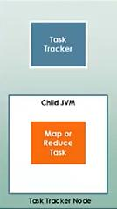
Classic MapReduce - Overview

Slide 19

Classic MapReduce - Overview
1. Client submits the MapReduce job.

Slide 20
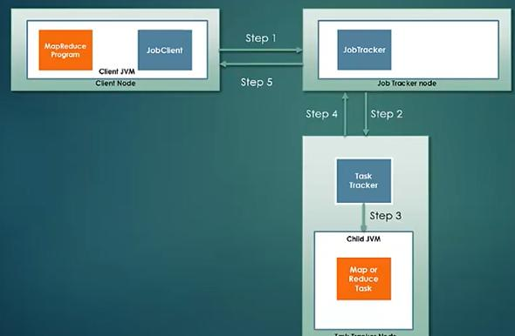
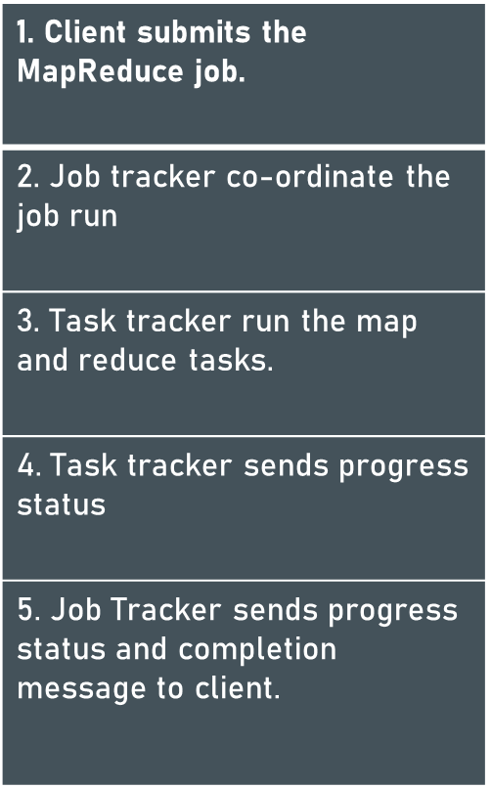
Classic MapReduce - Overview

Slide 21
Classic MapReduce - Overview

Slide 22
Classic MapReduce - Overview

Slide 23
Classic MapReduce - Overview

Slide 24
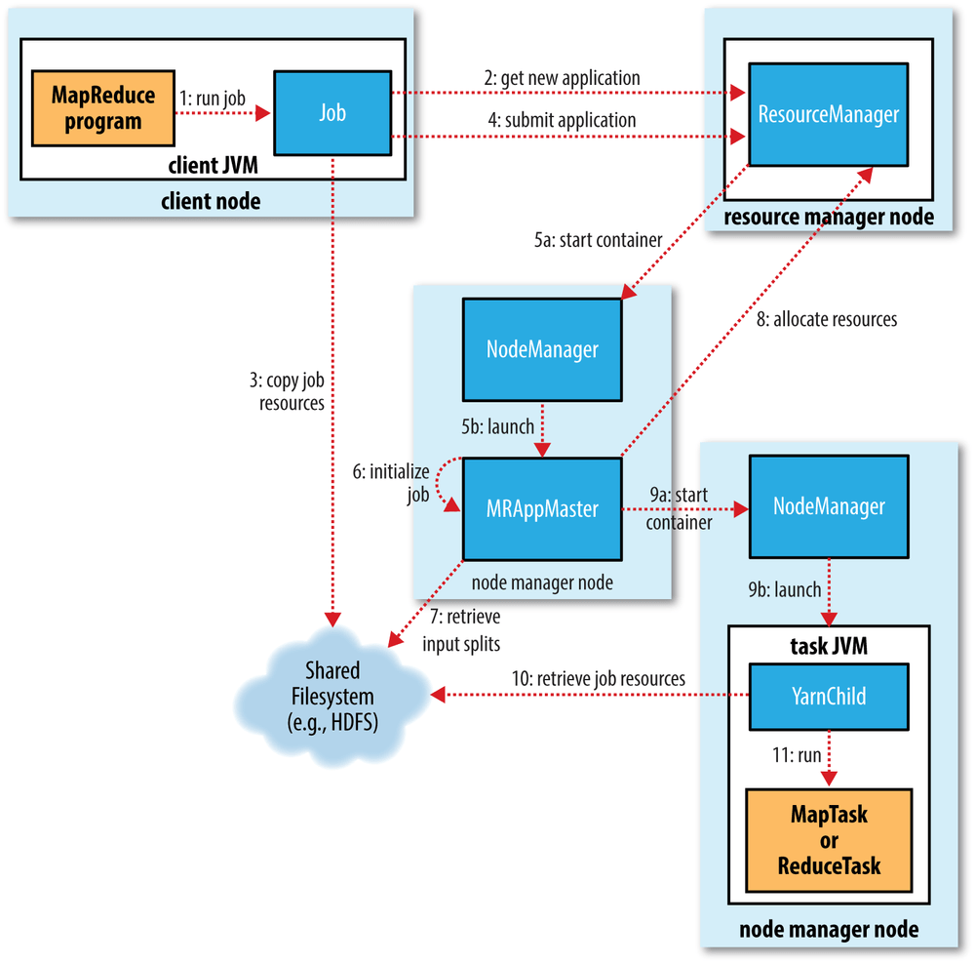

Slide 25
Components of MapReduce
Client
Yarn node manager
Yarn resource manager
MapReduce application master
Distributed Filesystem

Slide 26
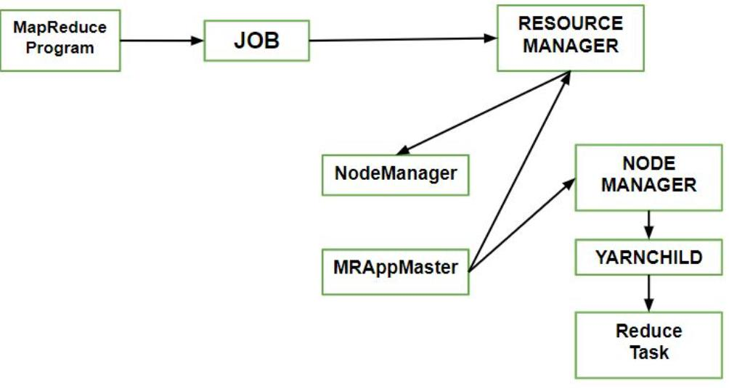
Components of MapReduce
Client 2. Yarn node manager 3. Yarn resource manager
4. MapReduce application master 5. Distributed Filesystem

Slide 27
How to submit Job?
use the submit()
submitJobInternal()
waitForCompletion()
reports the progress to the console.
job counters are displayed

Slide 28
How to submit Job?
use the submit()
submitJobInternal()
waitForCompletion()
reports the progress to the console.
job counters are displayed

Slide 29
How to submit Job?
use the submit()
submitJobInternal()
waitForCompletion()
reports the progress to the console.
job counters are displayed

Slide 30
How to submit Job?
use the submit()
submitJobInternal()
waitForCompletion()
reports the progress to the console.
job counters are displayed

Slide 31
How to submit Job?
use the submit()
submitJobInternal()
waitForCompletion()
reports the progress to the console.
job counters are displayed

Slide 32
Processes implemented by JobSubmitter for submitting the Job :
Processes implemented by JobSubmitter for submitting the Job :
The resource manager askes for a new application ID that is used for MapReduce Job ID.
Output specification of the job is checked.
If the splits cannot be computed, it computes the input splits for the job
Resources needed to run the job is copied

Slide 33
Processes implemented by JobSubmitter for submitting the Job :
Processes implemented by JobSubmitter for submitting the Job :
The resource manager askes for a new application ID that is used for MapReduce Job ID.
Output specification of the job is checked.
If the splits cannot be computed, it computes the input splits for the job
Resources needed to run the job is copied

Slide 34
Processes implemented by JobSubmitter for submitting the Job :
Processes implemented by JobSubmitter for submitting the Job :
The resource manager askes for a new application ID that is used for MapReduce Job ID.
Output specification of the job is checked.
If the splits cannot be computed, it computes the input splits for the job
Resources needed to run the job is copied

Slide 35
Processes implemented by JobSubmitter for submitting the Job :
Processes implemented by JobSubmitter for submitting the Job :
The resource manager askes for a new application ID that is used for MapReduce Job ID.
Output specification of the job is checked.
If the splits cannot be computed, it computes the input splits for the job
Resources needed to run the job is copied

Slide 36
Processes implemented by JobSubmitter for submitting the Job :
Processes implemented by JobSubmitter for submitting the Job :
It copies job JAR with a high replication factor, which is controlled by mapreduce.client.submit.file.replication property.
By calling submitApplication(), submits the job on the resource manager.

Slide 37
Processes implemented by JobSubmitter for submitting the Job :
Processes implemented by JobSubmitter for submitting the Job :
It copies job JAR with a high replication factor, which is controlled by mapreduce.client.submit.file.replication property.
By calling submitApplication(), submits the job on the resource manager.

